Slide 1
ADA Boosting Algorithm

Slide 2
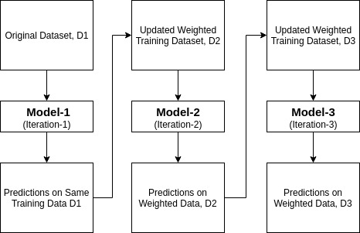
ADA Boost working:

Slide 3
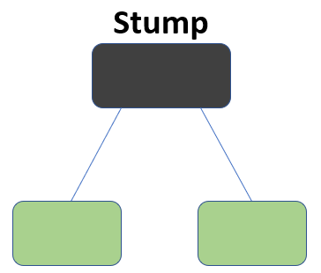
Stumps:
Each iteration is done by each stumps.
Iteration executed on the basis of amount of correctly classified data.

Slide 4
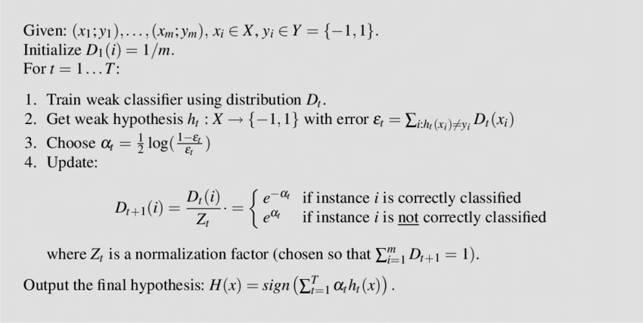
Weight Distribution:

Slide 5
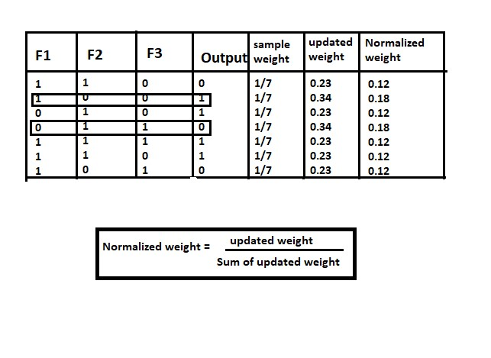
Sample Table for update and Normalized weight:
Correctly classified iteration will get less weight when compared to incorrect iteration.
Normalized weight is used to get total sum = 1

